Slide 1
LMS Application
Technology stack:
UI: Angular, standalone component
Backend: .net core 8, Entity Framework, Clean architecture.
Database: SQL
Security:
Authentication using JWT token, Policy based authorization for admin and user role.

Slide 2
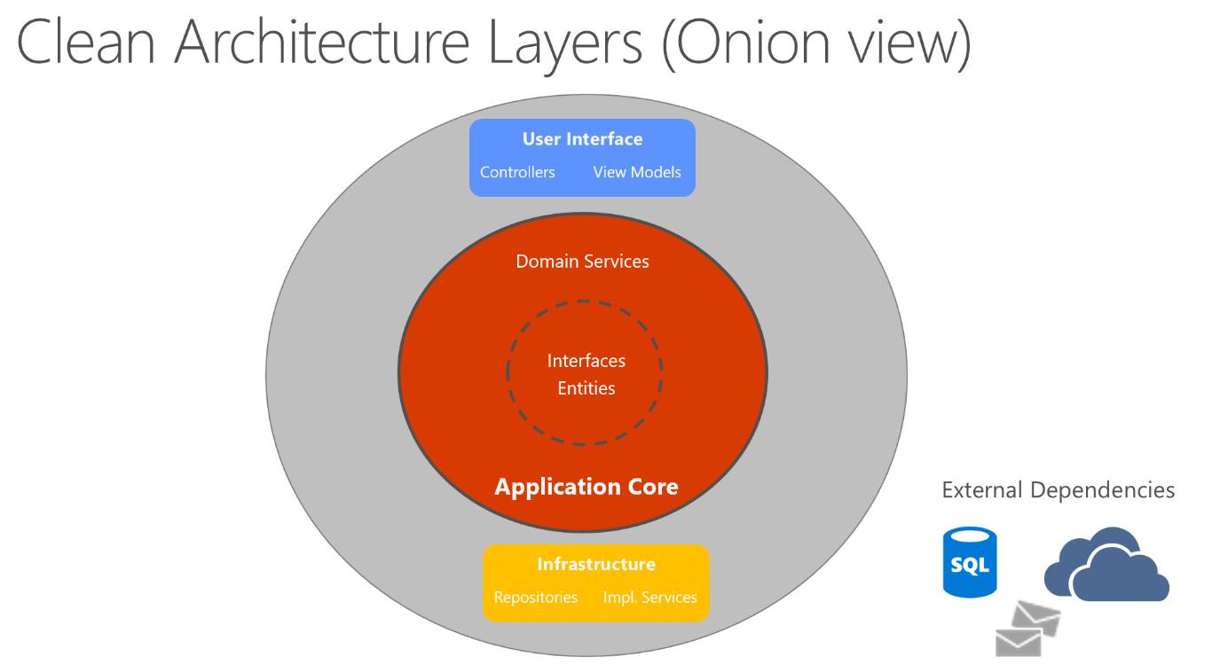
Architecture

Slide 3
Features
Admin:
Login - Default admin user added using seed logic when using fresh database.
Add user - Admin can add user and user can be able to login with the email and password.
Manage Users
Users List - Admin role users can able to view all the users available in the system and able to update the user details.
Delete - Only Admin role users can delete the users.
Manage Leaves
Admin users can able to view the list of leaves applied by the users and can able to approve or reject leaves.

Slide 4
Feature
User role:
Login - users can login into the system with the email and password created by admin
Manage Leaves
Apply for leaves
View list of leaves applied with the status.

